Slide 1
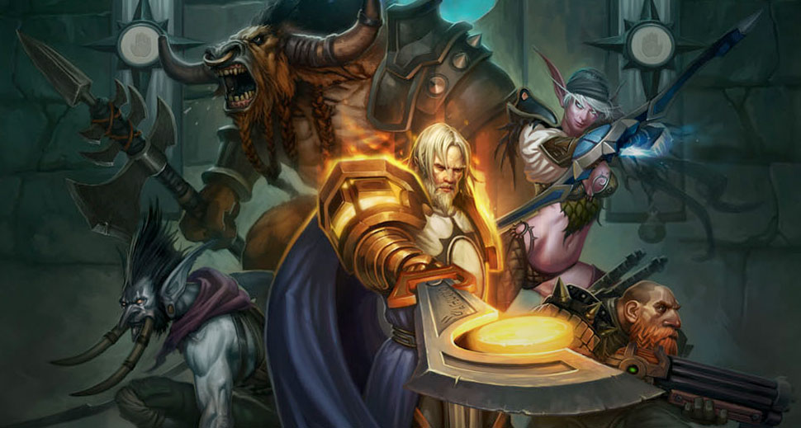
GA 3331 – Game Prototyping
Week 4
UDK

Slide 2
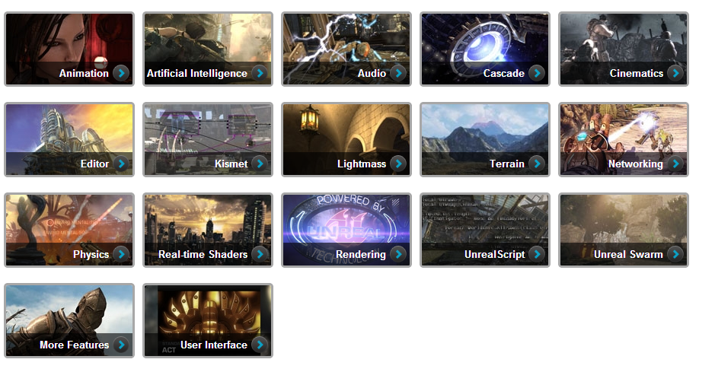
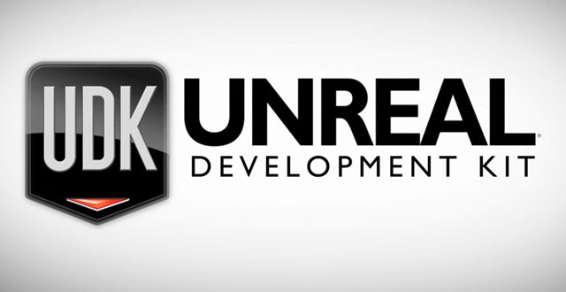
What is UDK (Unreal Development Kit)
The free edition of Unreal Engine 3

Slide 3
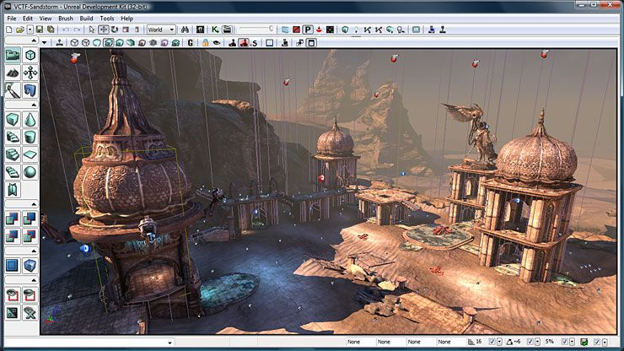
What is UDK (Unreal Development Kit)
The Editor (with content)

Slide 4
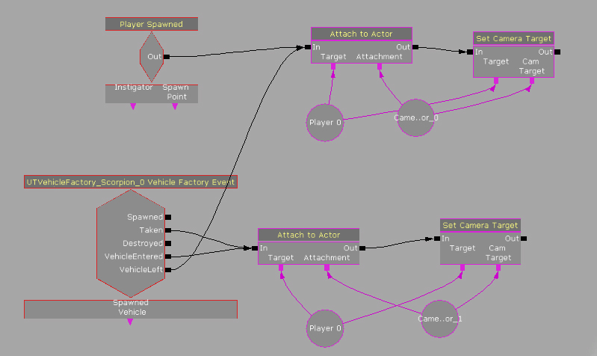
What is UDK (Unreal Development Kit)
Kismet

Slide 5
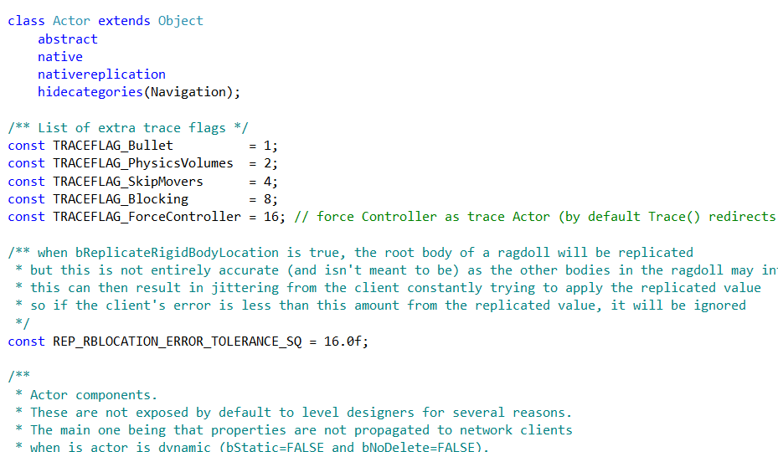
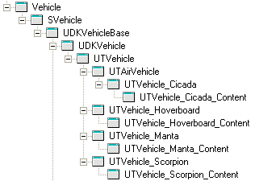
What else is UDK (Unreal Development Kit)
Unrealscript, for basic Unreal weapons and example gameplay

Slide 6
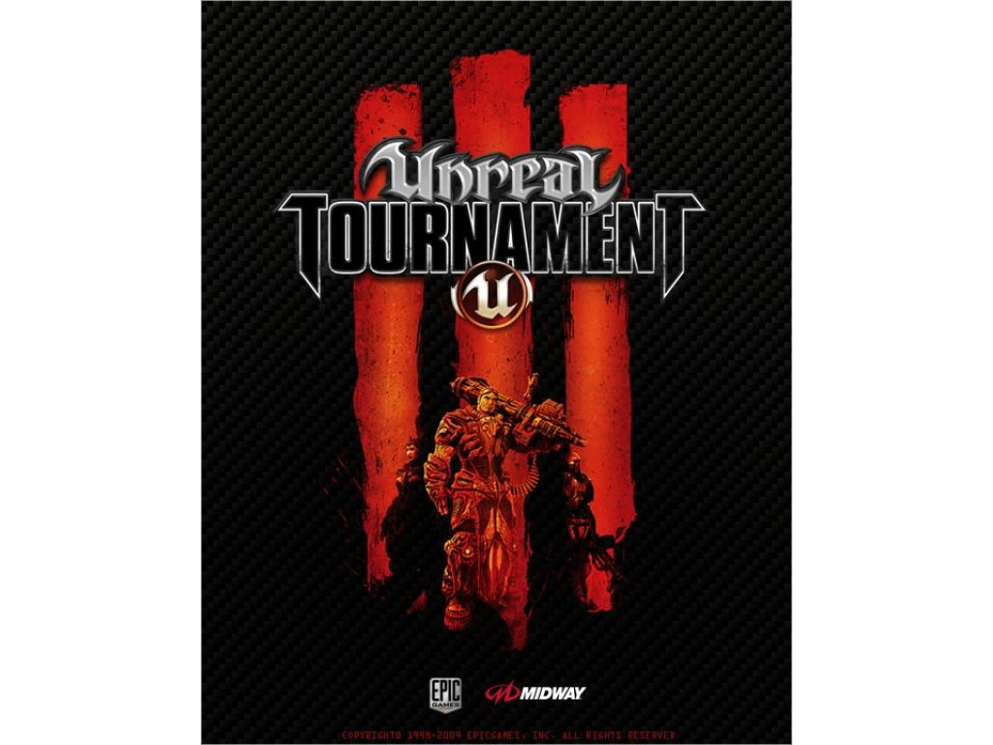
What isn’t UDK?
Native C++ code
A lot of Unreal content

Slide 7
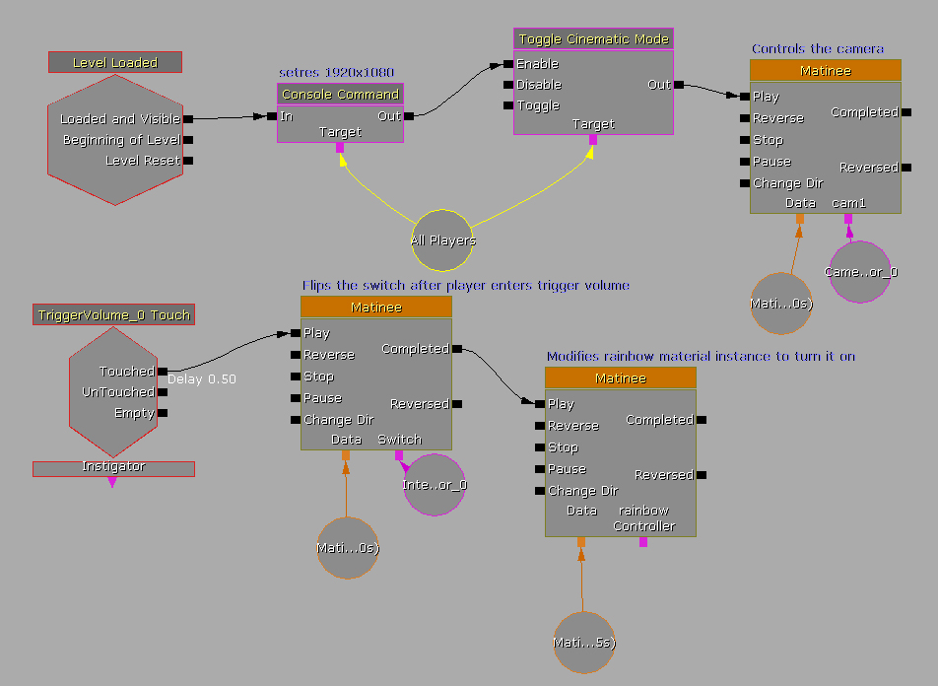
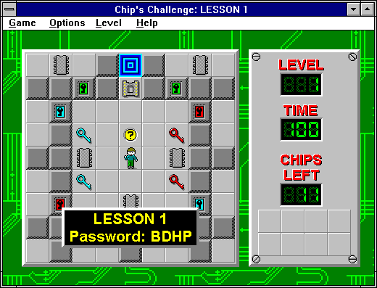
Lab #1
UDK – Triggers, Matinee, and Camera

Slide 8
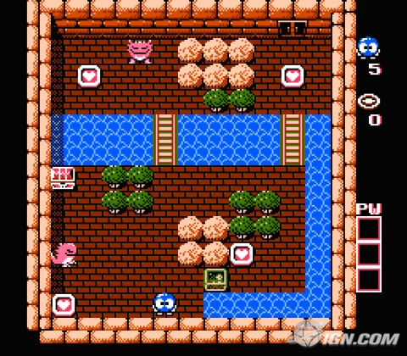
Lab #2
Prototype!

